Slide 1
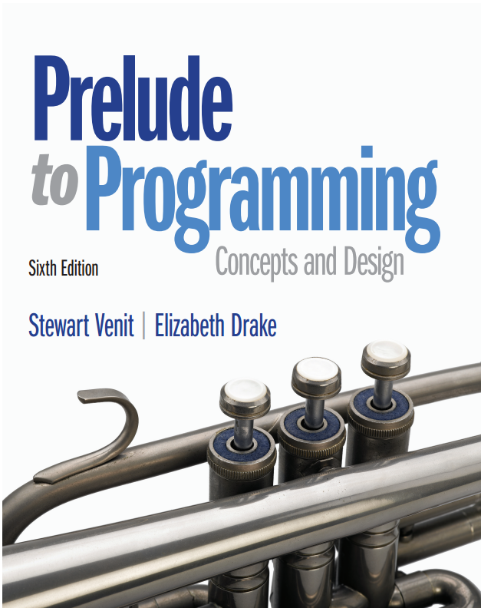
Prelude to Programming
Sixth Edition
Chapter 9
Program Modules, Subprograms, and Functions
Copyright © 2015, 2011, 2009 Pearson Education, Inc. All Rights Reserved
Notes:
If this PowerPoint presentation contains mathematical equations, you may need to check that your computer has the following installed:
1) MathType Plugin
2) Math Player (free versions available)
3) NVDA Reader (free versions available)

Slide 2
9.1 Data Flow Diagrams, Arguments, and Parameters
How is data transmitted between program submodules (or subprograms)?
parameters allow the program to transmit information between modules
data flow diagrams keep track of the data transmitted to and from each subprogram
If a data item in the main program is needed in a subprogram, its value must be passed to, or imported by that subprogram.
If a data item processed by a subprogram is needed in the main program, it must be returned to, or exported to that module.
We say that we pass a value to a subprogram and that subprogram may or may not return a value to the calling program.

Slide 3
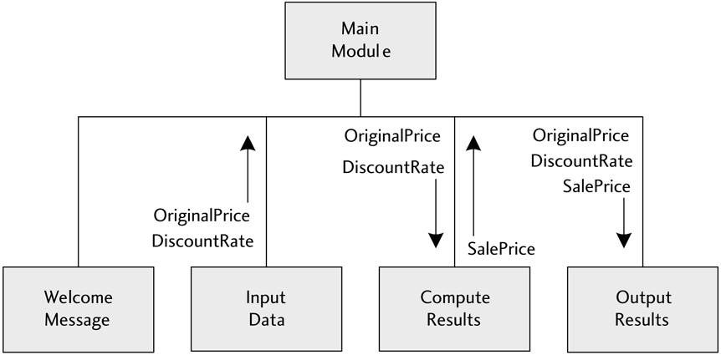
Data Flow Diagram [using the Sale Price Computation Problem from the text]

Slide 4
Parameters and Arguments (1 of 3)
Suppose we have designed a module whose purpose is to output the results of some calculations.
We need to pass the results of the calculations (the data) to that module so that it can display the output.
The syntax for defining a module that accepts data (has parameters) is shown below:
Call Subprogram Sub_Name(Var1, Var2, Var3)
The syntax for calling such a module and how to pass in the data (arguments) is shown below:
Sub_Name(V One, V Two, V Three)
Notice that the names of the variables that are used in the calling module do not need to be the same (and probably should not be the same) as the names in the called module.

Slide 5
Parameters and Arguments (2 of 3)
When a subprogram is called, the values of the arguments are assigned to corresponding parameters, based on the order of appearance in the two lists.
For example, when the subprogram with the header:
Subprogram Output_Results(OldPrice,Rate,NewPrice)
is called by the statement
Call Output_Results(OriginalPrice,DiscountRate,SalePrice)
the following occurs:
The value of the 1st argument (OriginalPrice) is assigned to the 1st parameter (OldPrice).
The value of the 2nd argument (DiscountRate) is assigned to the 2nd parameter (Rate).
The value of the last argument (SalePrice) is assigned to the last parameter (NewPrice).

Slide 6
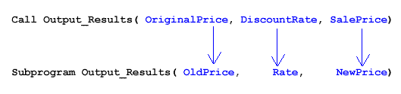
Sale Price Program Example

Slide 7
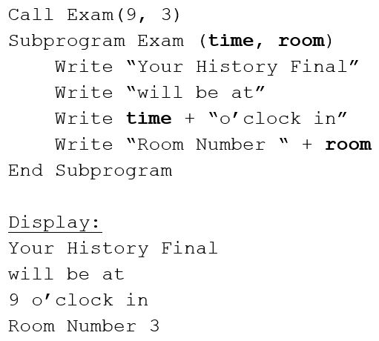
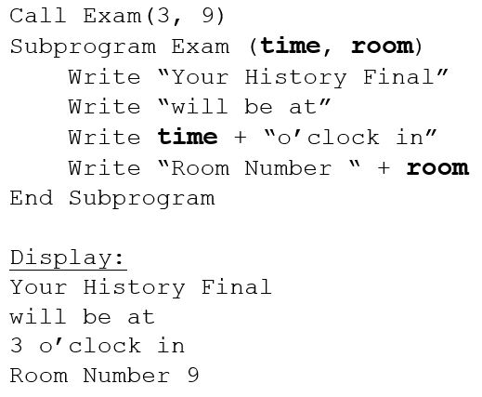

Parameters and Arguments (3 of 3)
The subprogram Exam displays the time and place of your History Final. The Final is at 9:00 o’clock in Room Number 3. See what could happen if the arguments are not passed in correct order!

Slide 8
Why Use Arguments and Parameters?
To enhance the usefulness of subprograms
They can be designed and coded independently of the main program and used in several different programs, if desired.
Only the structure of the subprogram is important; not the naming of its variables.
To make it easier for different programmers to design and code different subprograms
The programmer of a particular subprogram only needs to know what kinds of variables are transmitted to or from that module.
The programmer does not need to be concerned about how variables are named or used in the main program or in another subprogram.
To make testing and debugging easier
Subprograms or submodules are independent of the main program.

Slide 9
Assigning Data Types to Parameters
The data type of a parameter must be defined in the subprogram header
The data type of the argument sent in to a variable must be the same as the data type of that variable in the subprogram header.
Pseudocode to assign data types to parameters (used in this book):
The following syntax declares a subprogram with 3 variables – a String variable, an Integer variable, and a Float variable:
Subprogram Sub_Name(String Var1,Integer Var2, Float Var3)

Slide 10
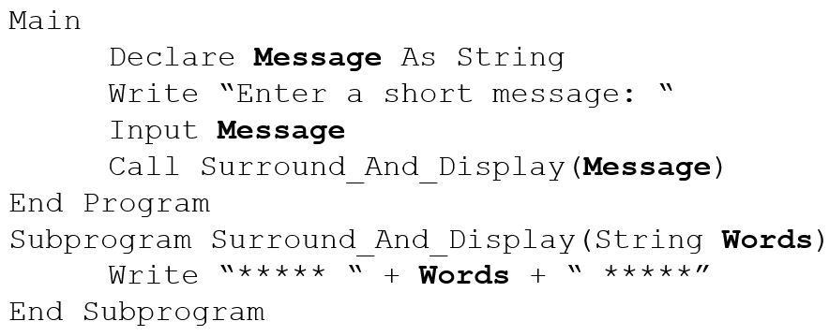
Example: Using a Subprogram to Format Output
This program displays a sequence of asterisks (*****) before and after a message.

Slide 11
9.2 More About Subprograms
Parameters can be passed by value and by reference.
Data may be sent from the call (main program) to the subprogram. This data is passed or imported to a subprogram.
Data may also be passed from the subprogram back to the call. This data is returned or exported to the main program.
The correspondence between arguments and parameters does not indicate which way the data is flowing.

Slide 12
Value and Reference Parameters
Value parameters have the property that changes to their values in the subprogram do not affect the value of the corresponding (argument) variables in the calling module. These parameters can only be used to import data into a subprogram.
Reference parameters have the property that changes in their values do affect the corresponding arguments in the calling module. They can be used to both import data into and export data from a subprogram.

Slide 13
To Pass by Value or Pass by Reference? [That is the question!]
Pass by value: When a variable is passed by value to a submodule, the submodule only receives a copy of that variable.
A separate storage location is created and the value of the variable is stored in that location.
Therefore, any changes made to that variable in the subprogram do not affect the original variable.
Pass by reference: When a variable is passed by reference, the submodule receives the actual storage location of that variable.
Therefore, changes made to the variable in the subprogram are also made to the original variable.

Slide 14
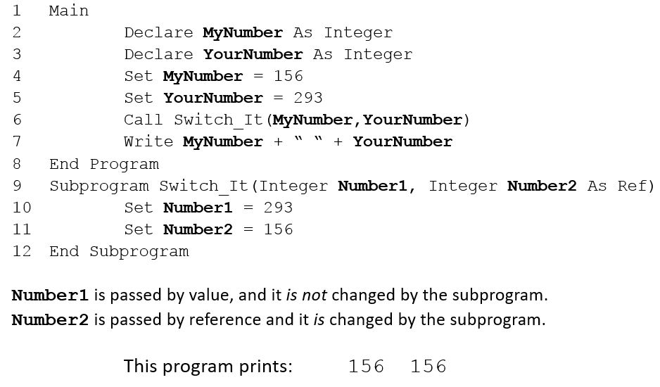
Example: Passing by Val and Passing by Ref

Slide 15
The To Upper()and To Lower() Functions
When a String value or variable is placed inside the parentheses of the To Upper() function, all characters in that string are converted to uppercase.
Similarly, when a String value or variable is placed inside the parentheses of the To Lower() function, all characters in the string are converted to lowercase.
These functions are helpful:
Allow users to type upper or lower case responses without getting errors
Create usernames or other identification techniques
And more…

Slide 16
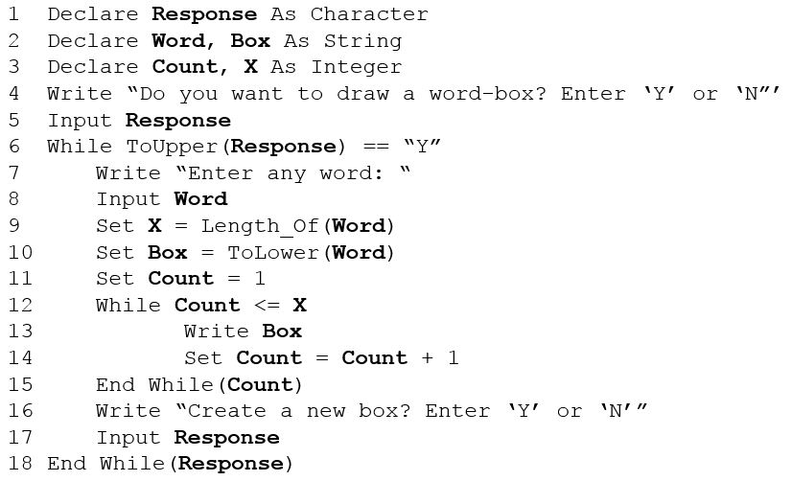
Example: Using ToUpper()and ToLower()

Slide 17
Be Careful When You Pass Variables Around!
Natalie and Nicholas are co-presidents of the Gamers at College club (G A C). They have created a web site and they want the site to be secure. Nick suggests that each member should have a secret login name and Natalie offers to write a program to achieve this. Unfortunately, Natalie did not study this chapter carefully and does not understand the difference between value parameters and reference parameters. She writes the pseudocode shown in the next two slides.

Slide 18
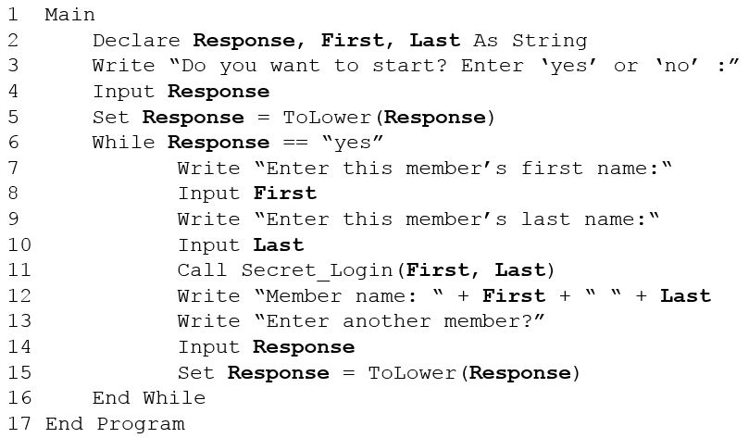
Passing Variables Carefully: Main program

Slide 19
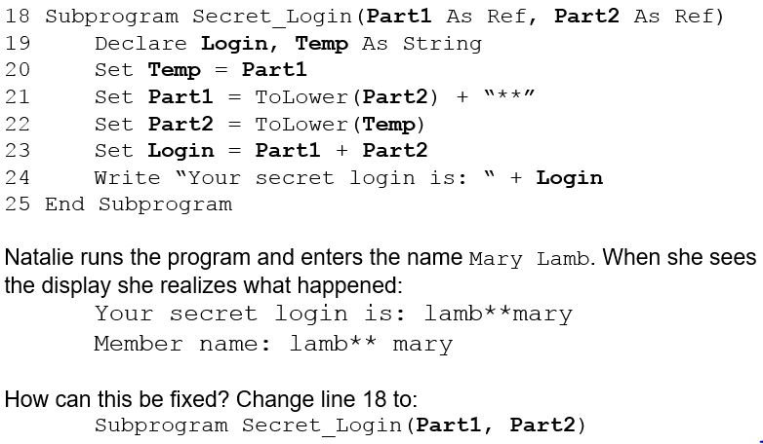
Passing Variables Carefully: Secret_Login Subprogram and Results

Slide 20
The Scope of a Variable
Scope of a variable:
The part of the program in which a given variable can be referenced is called the scope of that variable.
Global variables:
Global variables are those variables declared in the main program.
They are available to all subprograms and submodules.
Local variables:
Local variables are declared in a particular subprogram.
They are said to be local to that subprogram or module.
They can only be used inside that subprogram or module.

Slide 21
Properties of Local Variables
Local variables have the following properties:
When the value of a local variable changes in a subprogram, the value of a variable with the same name outside that subprogram remains unchanged.
When the value of a variable changes elsewhere in a program, a local variable with the same name remains unchanged in its subprogram.

Slide 22
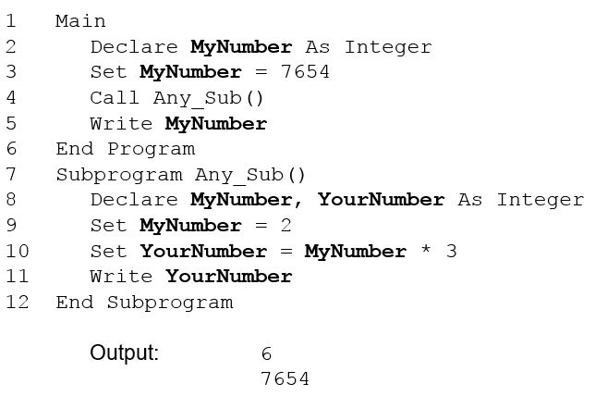
Using Local and Global Variables to Keep Track of MyNumber

Slide 23
Using Counters Locally (1 of 2)
Note that Count is used in both Main and Pay_Employee but, because it is declared locally in the subprogram, its value in the subprogram does not affect its value in Main.

Slide 24
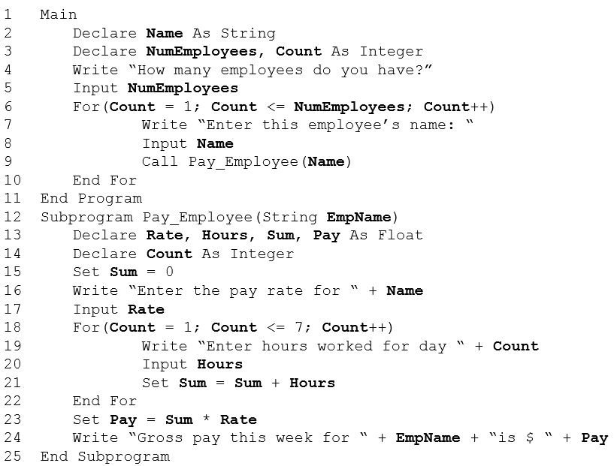
Using Counters Locally (2 of 2)

Slide 25
9.3 Functions (1 of 2)
A function is a subprogram whose name can be assigned a value. This allows the calling program to use the name of the function in an expression. Some examples were already introduced in earlier chapters. These functions, provided by the programming language, are called built-in functions.
computes the square root of the positive number X.
computes the integer obtained by discarding the fractional
part of the number X.
computes the integer obtained by rounding the number
X up to the next integer.
computes the integer obtained by discarding the
fractional part of the number X.

Slide 26
9.3 Functions (2 of 2)
Random generates a random integer (whole number) from 0.0 to 1.0, including 0.0 but not 1.0.
computes the length of the string S.
changes the value of all characters in a string, S, to
uppercase.
changes the value of all characters in a string, S, to
lowercase.

Slide 27
Built-in Functions
Most programming languages provide built-in functions. The code for these functions are supplied in separate modules (often called a library) and can be used by any programmer.
Some examples of built-in functions that we have not yet seen are:
computes and returns the absolute value of X. It is of type
Float.
rounds the real number, X, to the nearest whole number.
It is of type Integer.
converts the number X to a corresponding string. It is of
type String.

Slide 28
Examples Using Built-in Functions

Slide 29
User-Defined Functions
User-defined functions are created by the programmer.
The differences between a function and a subprogram are:
A function’s name may be assigned a value in the code that defines it.
A function is called by placing its name with its arguments anywhere in the program where a constant of the function’s type is allowed.

Slide 30
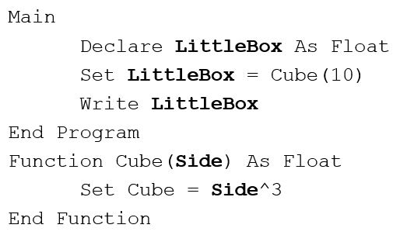
Example: The Cube Function
Since function calls evaluate to some value, the definition of the Function must include which data type the function evaluates to.
The following pseudocode shows the syntax for defining a Function that finds the cube of a number:

Slide 31
When to Use a Function
If the programming language you are using contains both functions and non-function subprograms, then either one may be used to implement a given program submodule.
If the submodule computes and returns a single value to the calling module, then implement it with a function.

Slide 32
Example: Getting Good Mileage Out of a Function (1 of 3)
The following program segment will compare the cost of several road trips by calculating miles per gallon used on each trip. By identifying the type of trip, it will compare highway miles and city miles.
The output required is a table that identifies the specific type of road trip, the total miles of each trip, and the miles per gallon used for each trip. Parallel arrays, as follows, are used to store this information:
A String array: Trip Name[10]
Two Float arrays: Trip Miles[10] and Trip M P G[10]

Slide 33
Example: Getting Good Mileage Out of a Function (2 of 3)
After the information for each trip is entered, the program will calculate the miles per gallon. A user-defined function named Answer() will be created to do this. It will receive the number of miles traveled and the number of gallons of gas used. The result of the Answer() function will be stored in the appropriate element in the Trip M P G[10] array.
Assume the following variables have been declared in the beginning of Main, as well as the three arrays previously mentioned:
Count and K as Integer variables
Name as a String variable
Miles and Gallons As Float variables
Continued on next slide

Slide 34
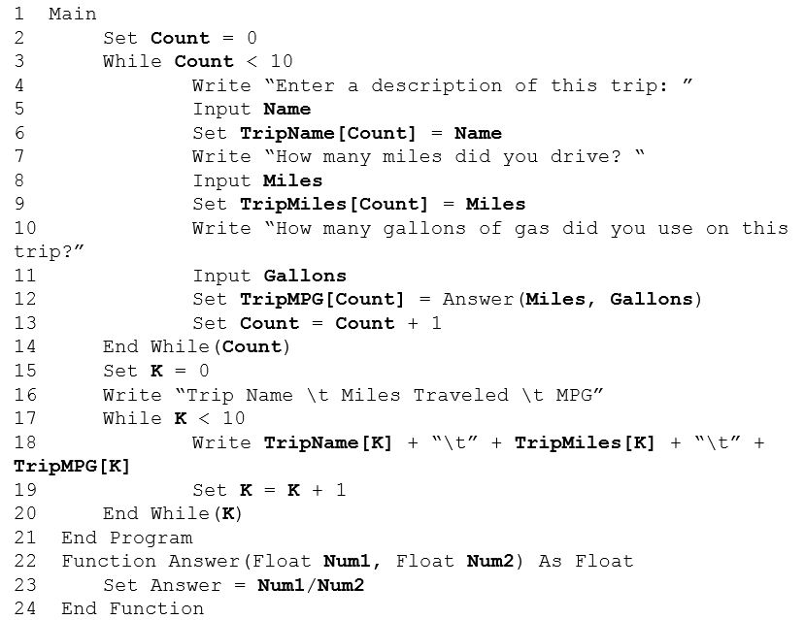
Example: Getting Good Mileage Out of a Function (3 of 3)

Slide 35
9.4 Recursion
A recursive subprogram is one that calls itself.
Some languages do not permit recursion.
Recursive subprograms may be an effective way to provide a solution for a specific problem.
Problems that are solved with recursion are those that can be easily described in terms of themselves.
Example: the sum of the first N integers can be written as:

Slide 36
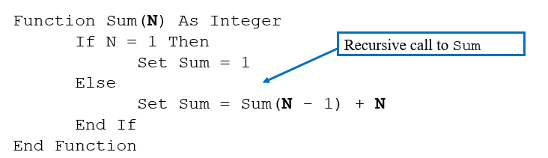
Example: Recursive Code to Sum N Positive Integers (1 of 5)
Tracing recursive code is difficult at first. The recursive call must be conditional, or there will be an infinite recursion. This is similar to a looping construct, but no repetition is used; there are only function calls to the function we are defining.

Slide 37
Example: Recursive Code to Sum N Positive Integers (2 of 5)
Suppose that this function is called by the statement
First call to the function: N = 4: Control goes to Else clause and line 5 is executed to get:
Second call to the function: The Else clause is executed now with
which causes the function to be called again with N = 2.

Slide 38
Example: Recursive Code to Sum N Positive Integers (3 of 5)
Third call to the function: The Else clause is executed with N = 2. The right side of the assignment statement is evaluated, giving:
Fourth (and last) call to the function: Since N = 1, this time the Then clause is executed and Sum is set equal to 1. Now the function does not call itself and execution of this call to the function is completed.
Continued on next slide.

Slide 39
Example: Recursive Code to Sum N Positive Integers (4 of 5)
Control now returns to the assignment statement on line 5 as:
in the third call to the function (where the last call to the function was made).
Here Sum(1) is replaced by 1 and Sum (on the left side) takes on the value 3. Execution of the third call is now complete.
Control now returns to the assignment statement as:
in the second call to the function. Here Sum(2) is replaced by 3 and Sum (on the left side) takes on the value 6. Execution of the second call is now complete.

Slide 40
Example: Recursive Code to Sum N Positive Integers (5 of 5)
Finally control returns to the assignment statement as:
in the first call to the function. Here Sum(3) is replaced by 6 and Sum (on the left side) takes on the value 10. Execution of the first call is now complete and Total (in the initial calling statement) is set equal to 10.

Slide 41

Copyright

